Slide 1

Executed SQL queries for inventory analysis of Beverage store
A Data-Driven Approach Using Intermediate Level SQL Queries to Explore Inventory Dynamics Prioritizing Products Based on Revenue Contribution and Sales Volume
by Bushra Fatima

Slide 2




Database Table Creation
Brand Data
Vendors Data
Table for brand-specific inventory.
Table for vendor-related information.
Inventory Data
Sales Data
Table for general inventory records.
Table for sales transactions.

Slide 3
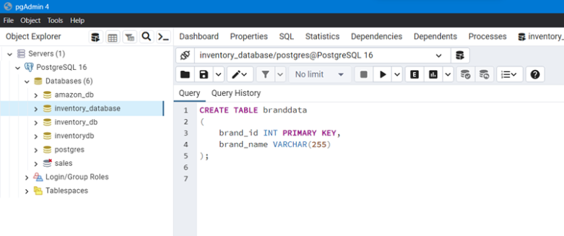
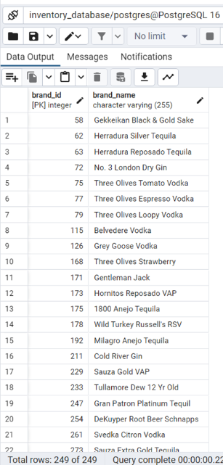
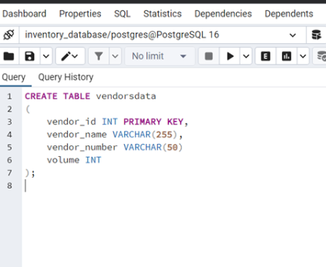
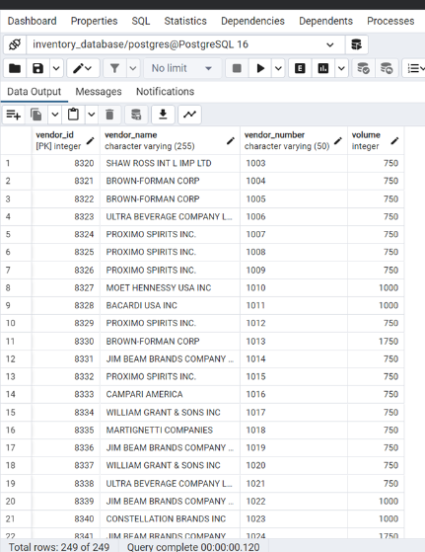
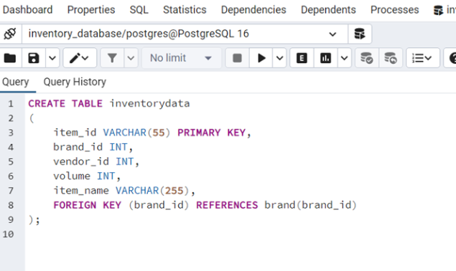
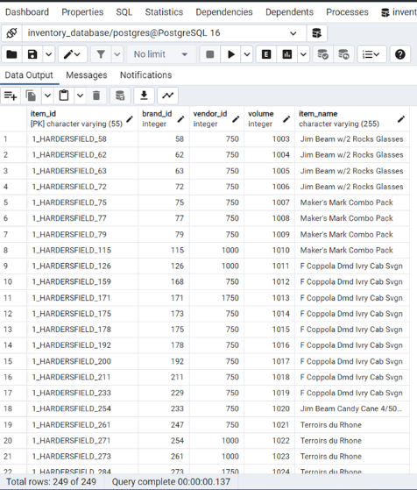
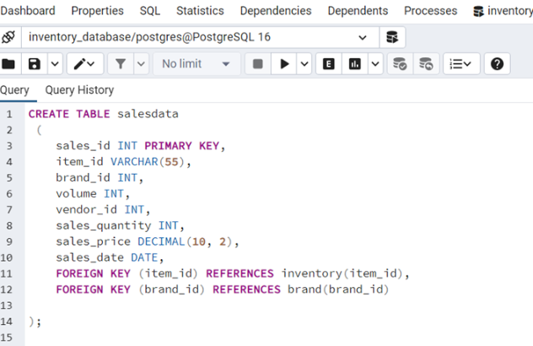
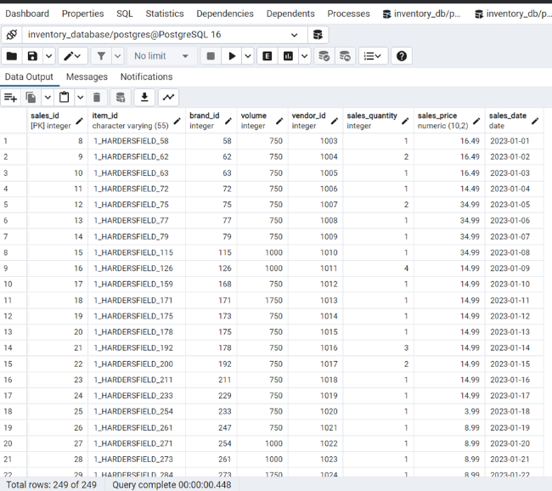
CREATING A TABLE branddata in database inventory_database using the query in POSTGRE SQL
The Result after the data is imported in table branddata
CREATING A TABLE vendorsdata in inventory_database using the query in POSTGRE SQL
Result after data is imported in table vendorsdata
CREATING A TABLE inventorydata in inventory_database using the query in POSTGRE SQL
The Result after data is imported in table inventorydata
CREATING A TABLE salesdata in inventory_database using the query in POSTGRE SQL
Result after data is imported in table salesdata

Slide 4
Inventory Insights
1
2
Total Volume
Sales Volume
By brand.
By brand.
3
4
Top Selling
Total Revenue
Items by volume.
By brand.

Slide 5
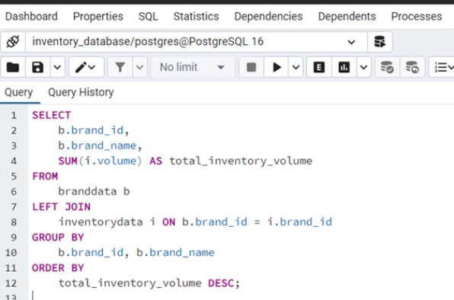
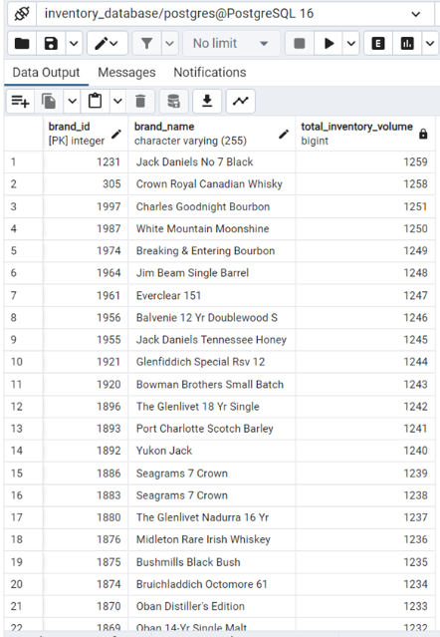
1. QUERY TO FIND TOTAL VOLUME OF INVENTORY BY BRAND
Result Of Query Total Volume Of Inventory By Brand

Slide 6
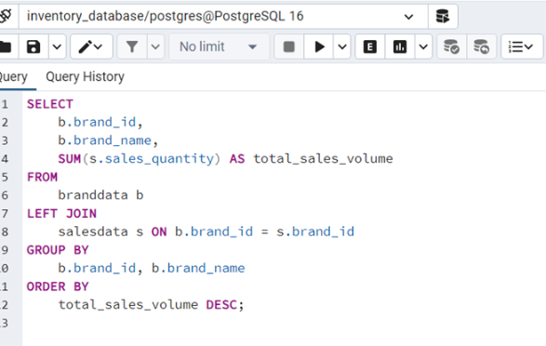
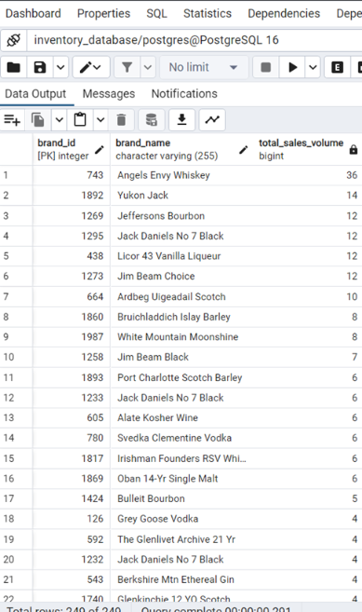
2.TOTAL SALES VOLUME BY BRAND
Results Of Query Total Sales Volume By Brand:

Slide 7
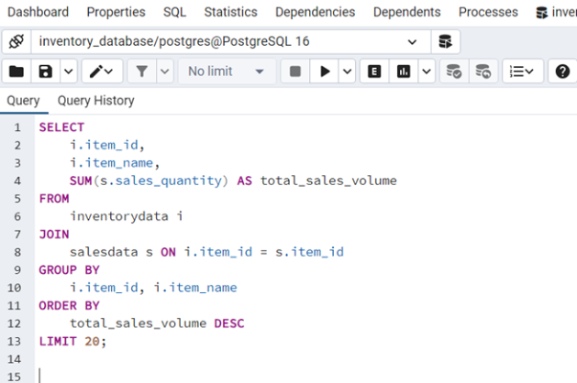
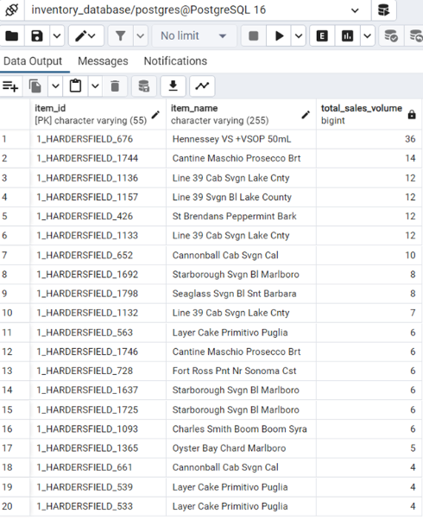
3.TOP SELLING ITEMS BY VOLUME
Result Of Query Top Selling Items By Volume

Slide 8
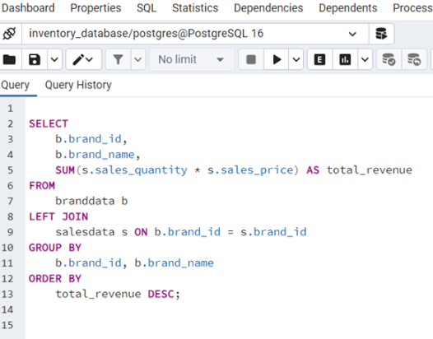
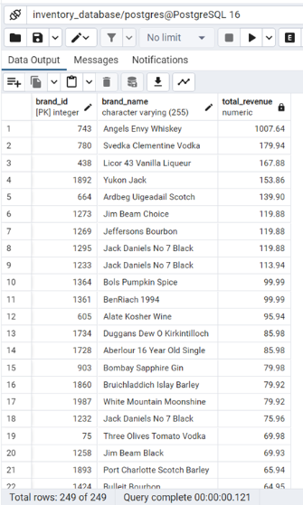
4.TOTAL REVENUE BY BRAND
Result Of Query Total Revenue By Brand

Slide 9

Inventory Challenges
1
Lowest Volume
2
Low Stock
Identify brand with minimal inventory.
Spot products that are low in stock.
3
Turnover Ratio
Calculate for inventory analysis.

Slide 10
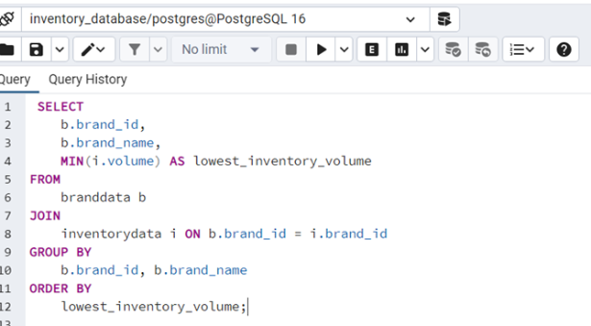
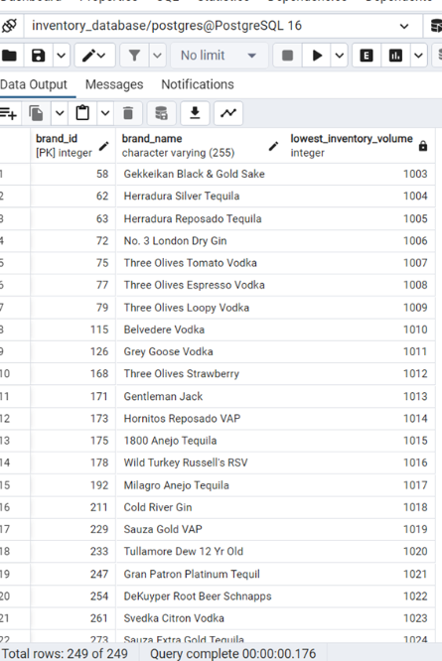
1. FIND THE BRAND WITH THE LOWEST INVENTORY VOLUME
Result Of Query Brand With The Lowest Inventory Volume

Slide 11
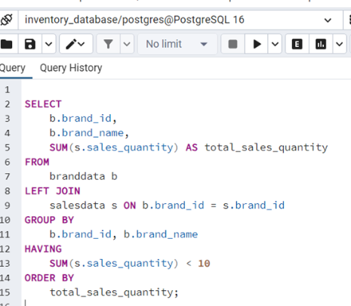
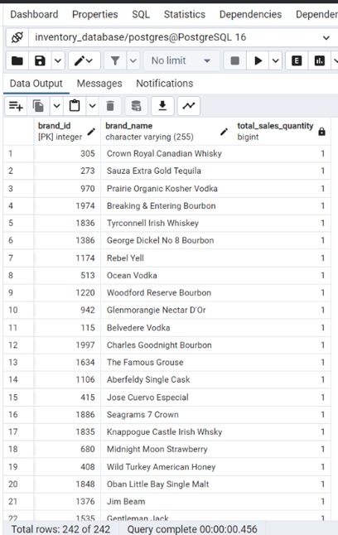
2.TO IDENTIFY LOW IN STOCK PRODUCTS
Result Of Query To Identify Low In Stock Products

Slide 12
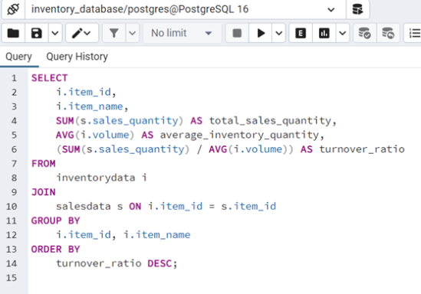
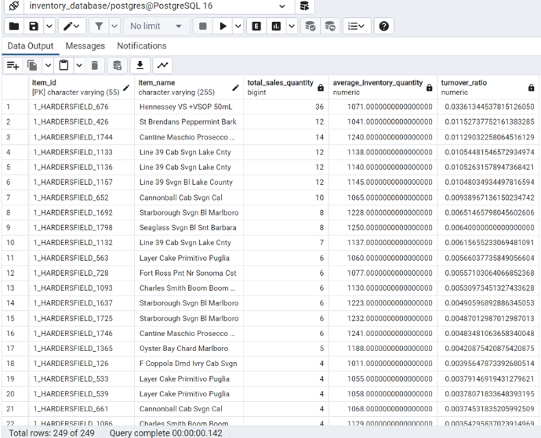
3.TO CALCULATE THE PRODUCT TURNOVER RATIO
Result Of Query To Calculate The Product Turnover Ratio

Slide 13

Sales Performance
1
Quarterly Revenue
Total sales revenue for each quarter.
2
Recent Sales Date
Most recent date for each product.
3
Average Price
Average sales price each month, last year.

Slide 14
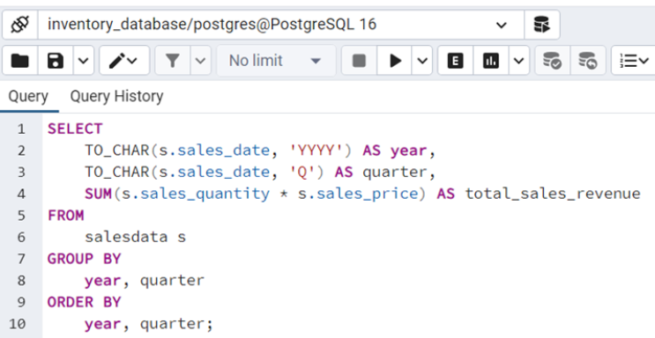
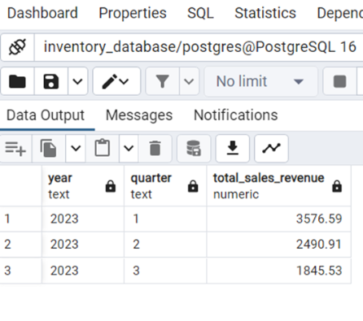
1.FIND THE TOTAL SALES REVENUE FOR EACH QUARTER
Query Of Result Total Sales Revenue For Each Quarter

Slide 15
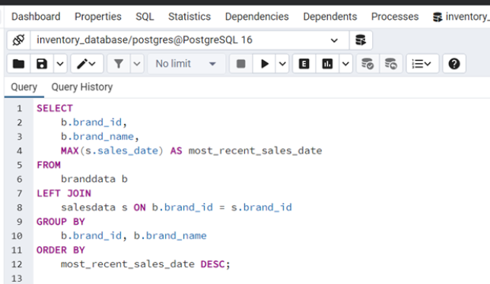
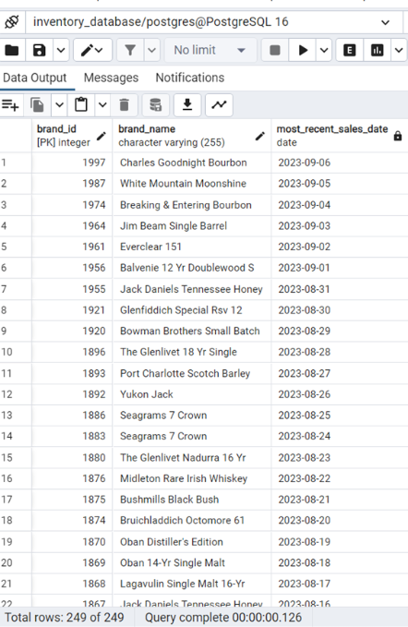
2.FIND THE MOST RECENT SALES DATE FOR EACH PRODUCT
Result Of Query Most Recent Sales Date For Each Products

Slide 16
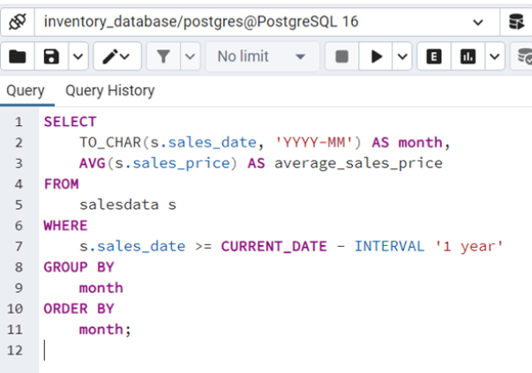
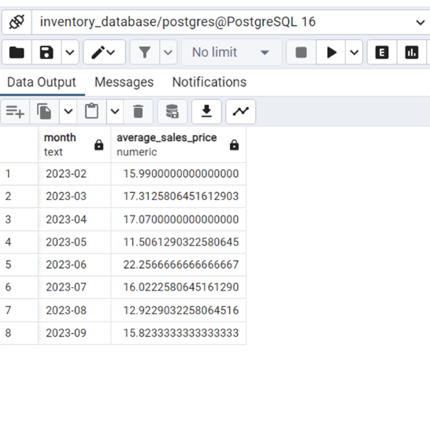
3.FIND THE AVERAGE SALES PRICE FOR EACH MONTH IN THE LAST YEAR
Find The Average Sales Price For Each Month In The Last Year

Slide 17
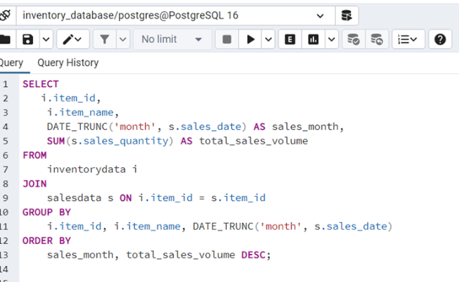
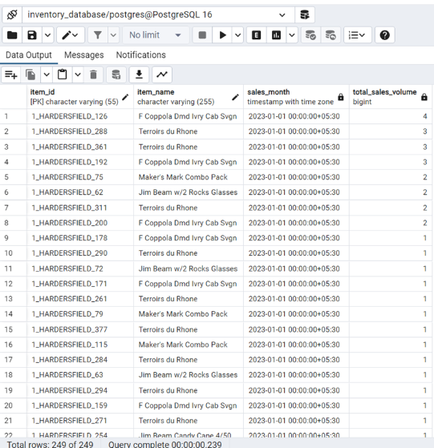
TOTAL SALES VOLUME BY PRODUCT AND MONTH
Result Of Query Total Sales Volume By Product And Month

Slide 18
Insight gained for Product Analysis
Product Turnover
Low in Stock
Recent Sales
Ratio for inventory analysis.
Identify products needing restock.
Date tracking for product freshness.

Slide 19
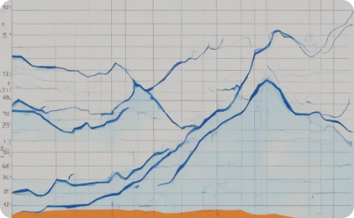


Monthly Sales Trends
Sales Volume
Average Price
Top Selling Items
By product and month.
Monthly average sales price.
Identified by volume.

